Slide 1
Human senses
Introduction to Psychology Fall 2023
By Selma Hamdani

Slide 2
Human Senses
Vision
Touch
Smell
Taste
Proprioception
Hearing

Slide 3
Class 1 Objectives
Each team will be responsible for one sense
As a team:
Conduct the sensation & perception experiments(s) assigned to you
Collect and record your data
Complete the report sheet (One per team, to be handed at the end class)
If we have time, each team will present their experiment and findings, if not, we will do so next class

Slide 4
Class 2 Objectives
Team:
Create an experiment (Hypothesis to ‘hypothetical’ results) relating to the sense that you were assigned. You cannot copy the same experiment that was conducted in class.
Which brain area(s) is/are involved in this experiment?
Which imaging method would you use to investigate the brain area(s) involved in your experiment?
Individually:
Post-lab reflection

Slide 5
Vision – look over there!

Slide 6
Vision – X and 0 Activity Part 1
Hold the card at eye level about an arm’s length away. Make sure
that the cross is on the right.
Close your right eye and look directly at the cross with your left eye.
Notice that you can also see the dot.
Focus on the cross but be aware of the dot as you slowly bring the card toward your face.
STOP: what happens to the dot?
Write this down on your report sheet (one per team)

Slide 7
Vision – X and 0 Activity Part 2
The dot will disappear, and then reappear, as you bring the card toward your face.
Try moving the card closer and farther to pinpoint exactly where this happens.
Now close your left eye and look directly at the dot with your right eye.
This time the cross will disappear and reappear as you bring the card slowly toward your face.
Try the activity again, this time rotating the card so that the dot and cross are not directly across from each other. Are the results the same?
Write your response in your report sheet (one per team)

Slide 8
Vision – Extra experiment
With a partner
Hold your card at arm's length.
Have your partner measure the distance from the card to your eye.
Slowly move the card horizontally left and right and note where the cross disappears and reappears.
Have your partner measure the distance between the two places where the dot disappears and reappears.

Slide 9
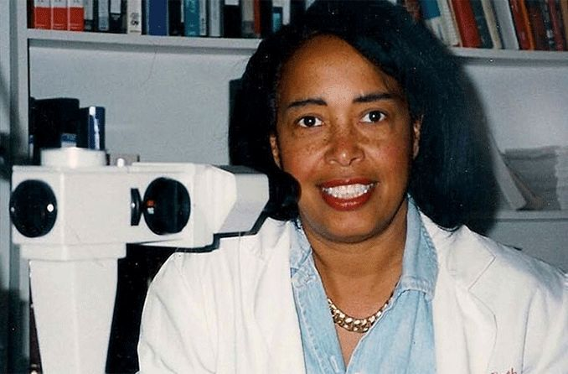
Vision – She is a vision
Source: Wikimedia Commons
Dr. Patricia Bath (1942-2019) was an ophthalmologist and laser scientist, and was the first woman chair of ophthalmology at a US university. She studied the causes of and cures for blindness, and invented a widely used method of using laser surgery to treat blindness caused by cataracts. Dr. Bath also co-founded the American Institute for the Prevention of Blindness.

Slide 10
Vision -What’s Going On?
The optic nerve—a bundle of nerve fibers that carries messages from your eye to your brain—passes through one spot on the light-sensitive lining, or retina, of your eye (see eye anatomy slide).
In this spot, your eye’s retina has no light receptors.
When you hold the card so the light from the dot falls on this spot, you cannot see the dot.
The fovea is an area of the retina that is densely packed with light receptors, giving you the sharpest vision.
Your brain automatically “fills in” the blind spot with a simple extrapolation of the image surrounding the blind spot.
This is why you don’t notice the blind spot in your day-to-day observations of the world.

Slide 11
Touch

Slide 12
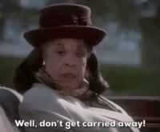
Touch – Touched by a… compass
Participant closes their eyes and KEEPS THEM CLOSED throughout
the experiment
The researcher informs the participant of the body parts that will be RESPECTFULLY touched by the compass
Researcher: choose a distance between the two points of the compass.
Enter that in the appropriate table space in the report sheet.
Ask the participant if they perceive One or Two points on their skin.
Record the results in the appropriate table space. Write Yes if the correct number of pressure points were perceived and No if the participant’s answer was incorrect.
DO NOT inform the participant of their results until the end of the experiment.
The table suggests 10 data points per participant, but feel free to add more if you want.

Slide 13
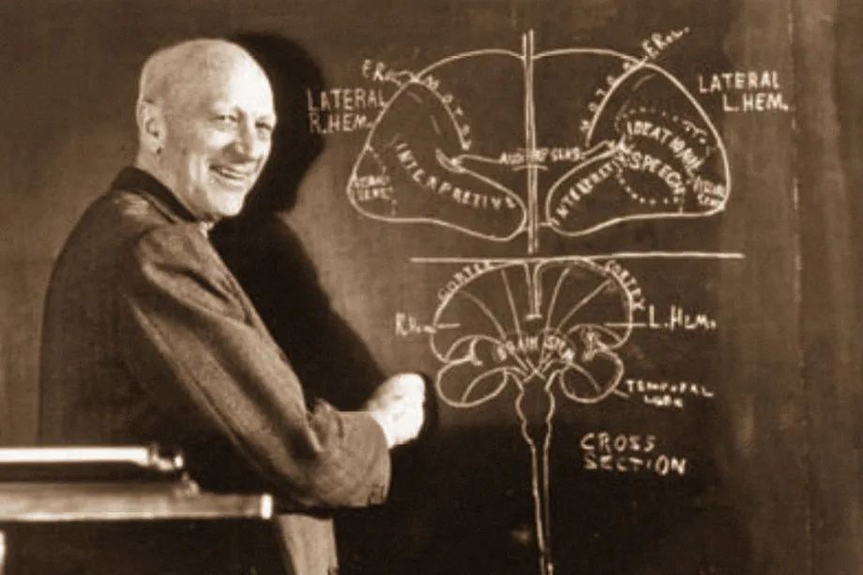
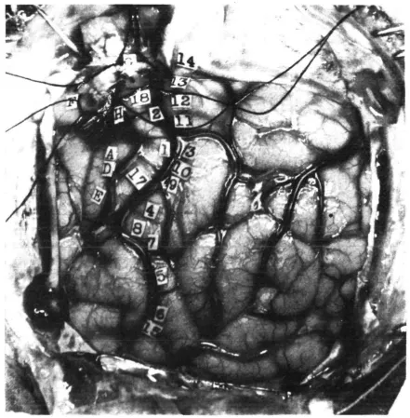
Touch – Penfield’s Montreal proceedure
https://youtu.be/pUOG2g4hj8s?si=chHxOxhkw2vHIvkG
Dr. Penfield and his colleagues established the
world's premier clinical, research and training center by developing surgical treatment for epilepsy, recording from the brain during surgery, establishing sophisticated behavioural tests for pre-and post-surgical evaluation, and making many other important advances.

Slide 14
Smell

Slide 15
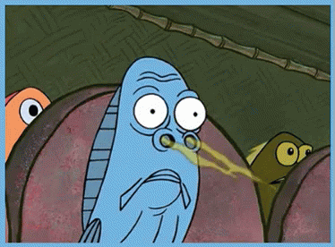
Smell – he who smelled it ….
This experiment is relatively straight forward and requires multiple participants
You will be provided with paper cups covered by a lid
Pierce the lid gently (without completely breaking it)
Each participant smells the cups TWICE 1 to 4 and in random order.
Participants try to guess the scent emanating from each cup and only informs the researcher, without sharing that information with the other participants
A researcher notes the guess of each participant in the designed table in the report sheet
Participants re-smell the content of cups 1 to 4 while smelling cup 5 between each cup.
They report their guesses to the researcher.

Slide 16
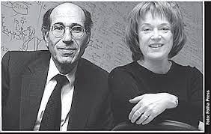
Smell – The nose knows
In 2004, two American scientists who discovered how people can smell and recall about 10,000 different odours were awarded the 2004 Nobel Prize in the category of physiology or medicine today.
The winners were Dr. Richard Axel, 58, a university professor at Columbia, and Dr. Linda B. Buck, 57, of the Fred Hutchinson Cancer Research Centre and University of Washington in Seattle.

Slide 17
Taste – the rainbow

Slide 18
Taste – Experiment 1
Participants close their nose firmly
A researcher hands them a candy that they must each without looking at it
Participants try to guess the flavour of the candy BEFORE opening their nose.
The researcher records the guess
Participants open their nose and note the flavour of the candy again
The researcher notes the second guess
Complete the appropriate report sheet

Slide 19
Taste – Experiment 2
Take a PTC paper
Place it in on the tip of your tongue and wait a few seconds (if you can)
What do you taste?
Discuss this phenomenon

Slide 20
Taste – Experiment 2

Slide 21
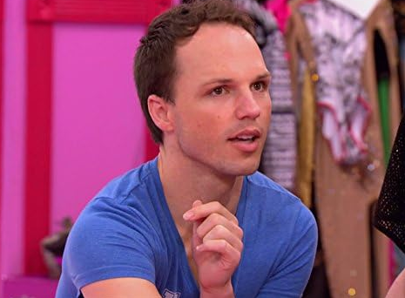
Taste – Experiment 3 Magic Berry
Participants taste the sour substances (lemon, sour patch candy, vinegar)
Researcher notes the response of the participant
Participants consume the magic berry (let it dissolve in your mouth, DO NOT CHEW)
Participants re-taste the previous substances
Researcher notes the response of the participant
Not this Barry …

Slide 22
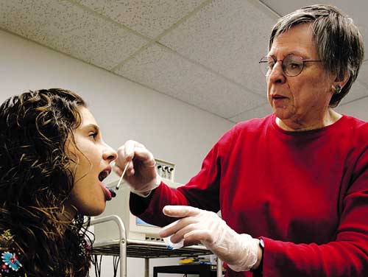
Taste
Why we like the foods we like
Linda Bartoshuk, PhD, an APA fellow, is the Bushnell professor of food science and human nutrition at the University of Florida and director for psychophysical research at the university’s Center for Smell and Taste. Bartoshuk studies sensory perception of foods such as taste, olfaction and irritation/pain. She is known for her discovery of supertasters, people who have more taste buds than the average person
https://www.apa.org/news/podcasts/speaking-of-psychology/foods-we-like

Slide 23
Proprioception

Slide 24
Proprioception -
Participants hold a piece of paper against a table top with one hand and hold a pencil in the other.
They mark an X on the paper.
Next, they raise their pencil hand above their head, close their eyes, and make a dot on the paper as near to the X as possible.
Participants open their eyes, see their dots and X. Then close their eyes again.
They raise their hand above their head again, close their eyes, and attempt to make a dot closer to the X again.
The researcher identifies each attempt (first, second etc.)
Do this 5 times.
Finally, participants open their eyes and check their success.

Slide 25
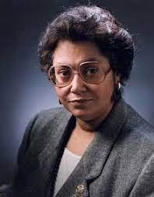
Proprioception
Dr. Patricia Cowings (1948- present), pictured above, is a psychophysiologist who trained as an astronaut at NASA, and was an alternate to go into space in 1979. Interested in human potential, she researched and developed individually tailored protocols to prevent motion sickness in astronauts. Her Autogenic Feedback Training Exercise has been used widely. Dr. Cowings is the Principal investigator of Psychophysiological Research Laboratories at NASA Ames Research Centre

Slide 26
Hearing

Slide 27
Hearing – Can you hear me now
Make a 3 Xs (or 4 if possible) on the floor with tape at roughly 1m to 1.5 apart. Identify one X as the standing point of the participants.
Place a blindfolded participant the standing X. and ask them to block one ear firmly with their finger
The researcher stand on one of the points away from the X.
The researcher says the subject's name.
The subject must now determine which X the researcher was standing on.
Repeat until all Xs have been explored.
The researcher notes the responses of each participant in the appropriate response sheet section.
Redo the experiment with participants using both ears.
The researcher notes the responses of the participants in the appropriate response sheet section.

Slide 28
Hearing – extra experiment
Re-do the experiment while the researcher says another name, not the name of the participant.

Slide 29
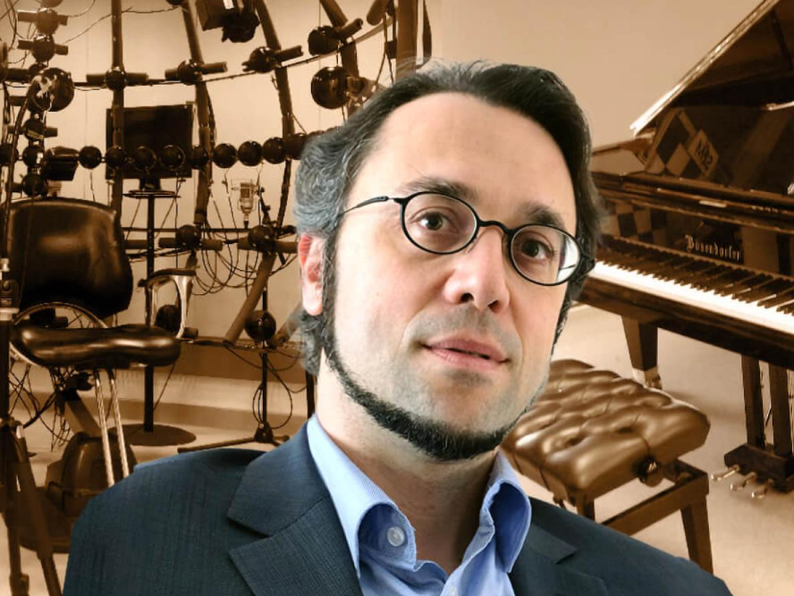
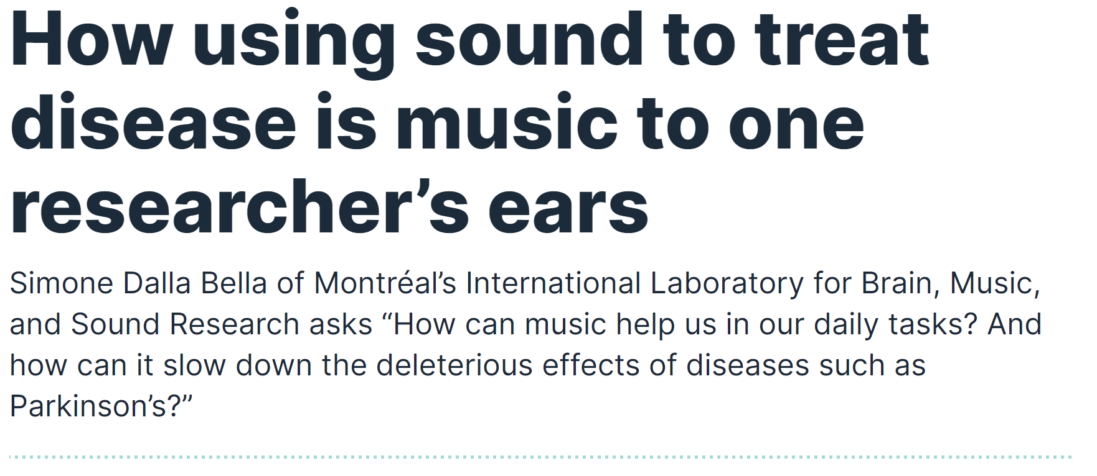
Hearing – papa can you hear me?
https://www.innovation.ca/projects-results/research-stories/how-using-sound-treat-disease-music-one-researchers-ears

